Slide 1
Recursion
Md. Imran Bin Azad
BSc Hons, MS (DU)
Lecturer, Eastern University

Slide 2
Print 1 to N
Print N to 1
Linear Search
Find gcd(a,b)
Find N^{th} fibonacci number
Binary Search

Slide 3
Bigmod
Given 3 integers: A, B, M
Calculate, A^{B} % M

Slide 4
Bigmod
Given 3 integers: A, B, M
Calculate, A^{B} % M
Hint
7⁸ = 7⁴ x 7⁴
5⁵⁷ = 5²⁸ x 5²⁸ x 5

Slide 5
Generate all possible subsets
A : {1, 3, 5, 7, 10}
Subsets: {1}, {3}, {5}, {7}, {10}, {1,3}, {1,5}, {1,7}, {1,10}, {1,3,5}, {1,3,7}, ….., {5,7,10} ………, {1,3,5,7,10}
uva 10776

Slide 6
Generate all possible subsets
Variations:
Find all subsets where subset sum = N
Find all subsets where subset sum is odd/even

Slide 7
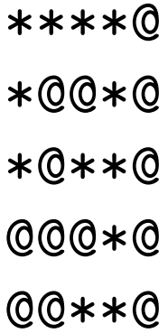
Flood Fill

Slide 8
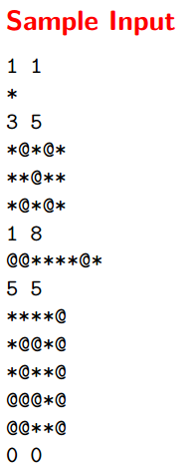
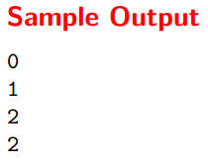
Flood Fill
UVa 572

Slide 9
Flood Fill
Other Problems
UVa: 352, 705, 11101, 11110

Slide 10
^{n}C_{r}
A : {1, 3, 5, 7, 10}
In how many ways can you pick 2 numbers from this set?
Ans: ⁵C₂
^{n}C_{r} = ^{n-1}C_{r} + ^{n-1}C_{r-1}
UVa: 369

Slide 11
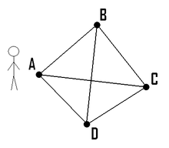
Travelling Salesman Problem

Slide 12
Other topics
Tower of Hanoi
Josephus Problem
UVa 628

